Slide 1
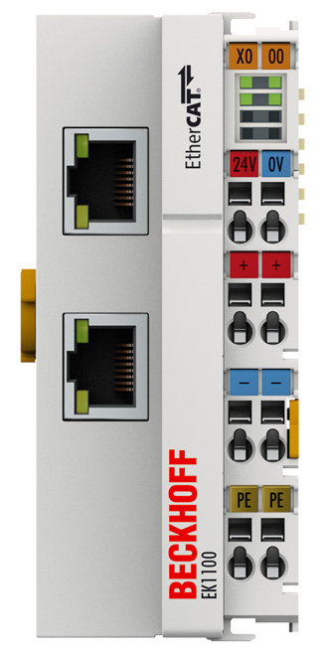
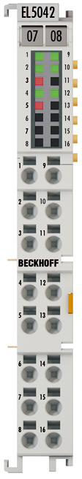
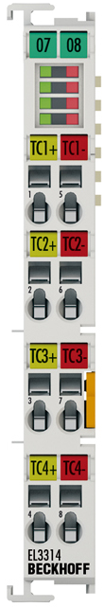
BECKHOFF slave connection
可拆用的分離圖

Slide 2
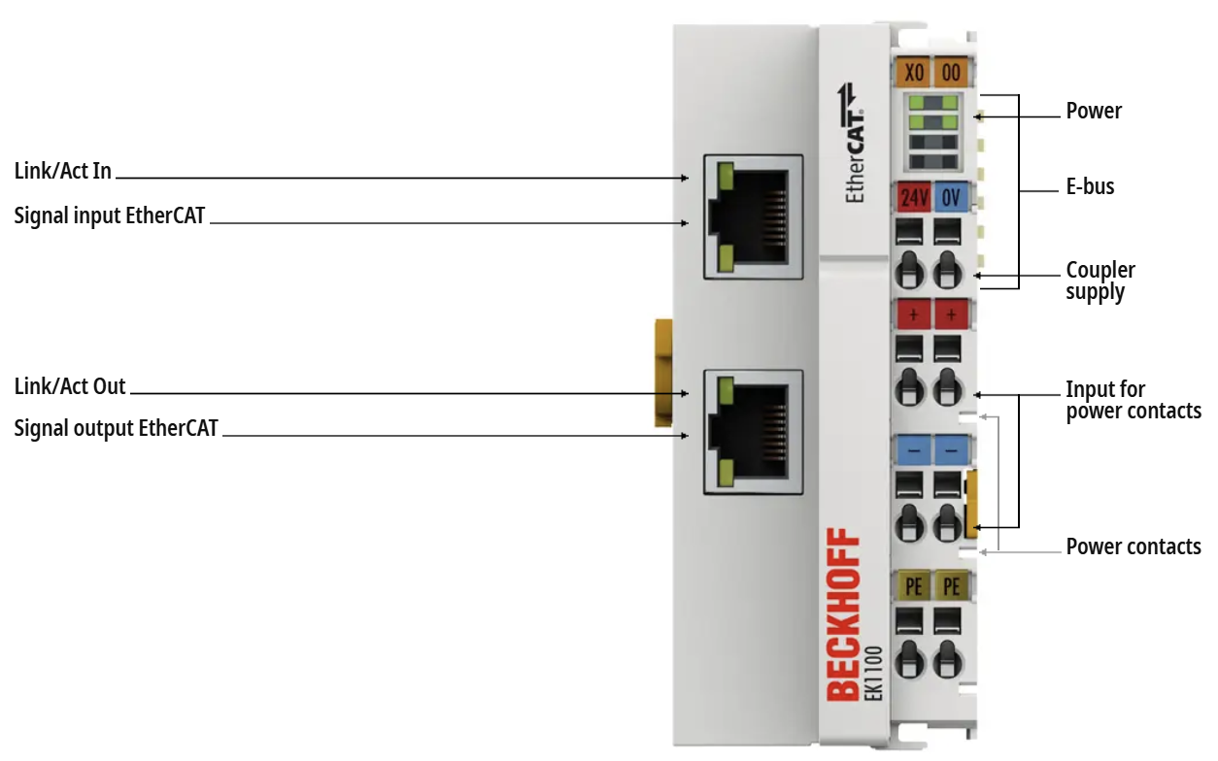

EK1100 | EtherCAT Coupler

Slide 3
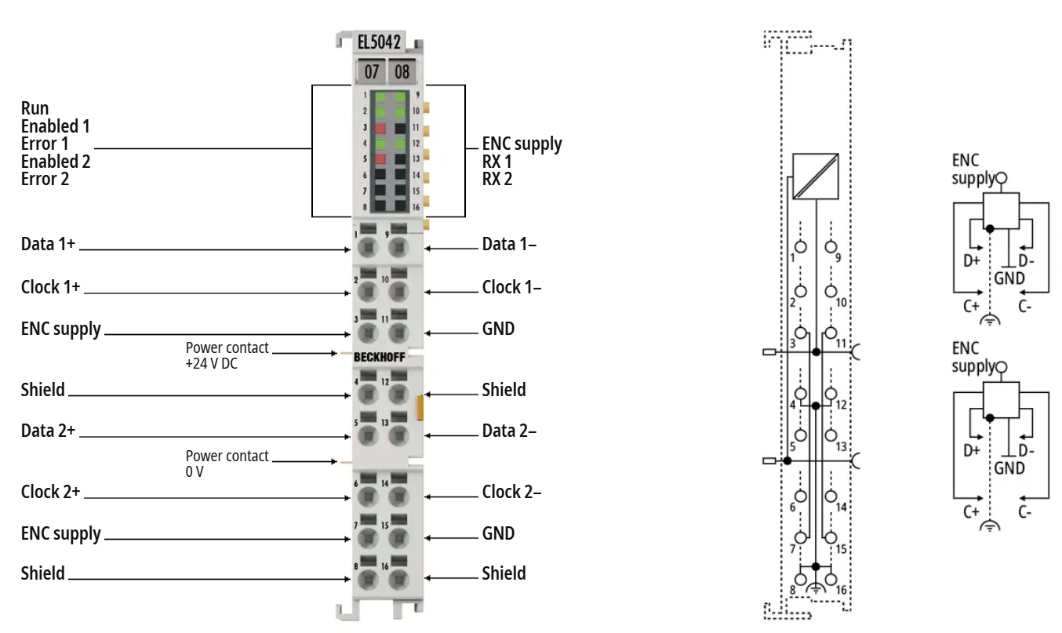

EL5042 | EtherCAT Terminal, 2-channel encoder interface, BiSS® C

Slide 4
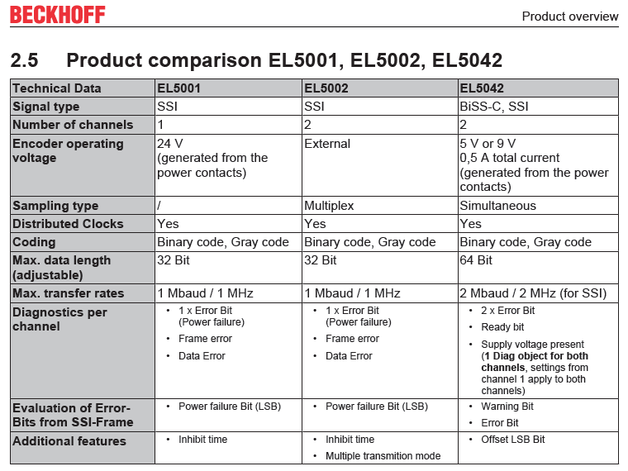

Slide 5
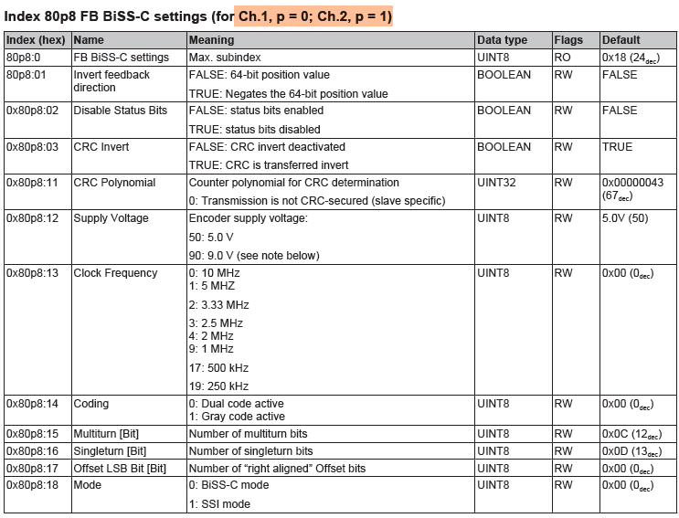
每片有兩個channel
ch1用8008
ch2用8018

Slide 6
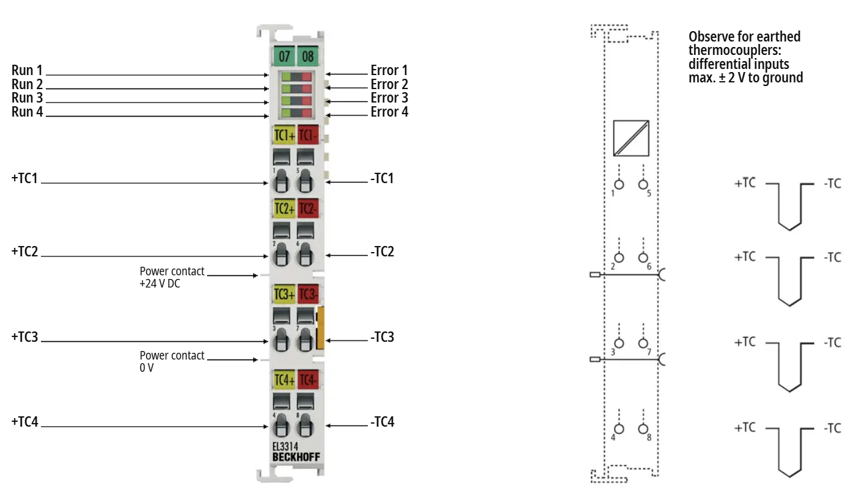

EL3314 | EtherCAT Terminal, 4-channel analog input, temperature, thermocouple, 16 bit

Slide 7
